Slide 1


Adam Horvath
24/10/2025

Slide 2

Outline
Executive Summary
Introduction
Methodology
Results
Conclusion
Appendix

Slide 3
Executive Summary
This project identifies key factors driving successful SpaceX Falcon 9 first-stage landings to enable competitive launch bidding.
Methodology Summary: Data was collected via the SpaceX REST API and web scraping of Wikipedia. The dataset was wrangled to create a binary success/failure outcome variable. Exploratory analysis leveraged visualizations (payload, launch site, flight number, and yearly trends) and SQL queries (total payload mass, success ranges, and mission outcome counts). Interactive analytics used Folium to map launch site proximity to geographical features and Plotly Dash to visualize success rates and optimal payload ranges. Predictive models—Logistic Regression, SVM, Decision Tree, and KNN—were trained and evaluated.
Results:
EDA: Launch success has significantly improved over time. KSC LC-39A leads with the highest success rate among sites. Orbits ES-L1, GEO, HEO, and SSO achieved 100% success.
Visualization/Analytics: All launch sites are strategically located near the equator and coastline to optimize orbital insertion and recovery logistics.
Predictive Analytics: All models performed comparably, with the Decision Tree slightly outperforming others on the test set.

Slide 4
Introduction
Background
SpaceX has transformed spaceflight by making it more accessible and cost-effective, achieving milestones such as resupplying the International Space Station, deploying the Starlink satellite constellation, and conducting crewed missions. The cornerstone of this affordability is the Falcon 9’s reusable first stage, which reduces launch costs to approximately $62 million—versus $165 million or more for competitors unable to recover their boosters. Accurately predicting first-stage landing success is critical for estimating total mission costs and enabling competitive pricing in the commercial launch market.
Explore
The influence of payload mass, launch site, flight number, and orbit type on first-stage landing success
The evolution of landing success rates over time
The most accurate machine learning model for binary classification of landing outcomes
Using public SpaceX data, this analysis delivers actionable insights to forecast reusability and optimize launch economics.

Slide 5

Section 1

Slide 6
Methodology
Data Collection – Using SpaceX Rest API and web-scraping techniques
Data Wrangling – Merging, cleaning and filtering the data by handling missing values. Using one hot encoding and feature extraction in preparation of data analysis and modeling.
Exploratory data analysis (EDA) – Plotting the data for visualization and using SQL for analysis
Data visualization – Using Folium to visualize the launch sites and creating an interactive map with Dash and Plotly
Machine learning prediction – Using various machine learning models to predict predict landing outcomes. Ensembles classifiers with tuning

Slide 7
Data Collection
Data collection methodology
The data was collected directly from the SpaceX REST API using the endpoint https://api.spacexdata.com/v4/launches. This gave detailed records for every SpaceX mission, including rocket configuration, payload details, launch site, landing type, and outcome. Since we’re only interested in Falcon 9, we filtered the results to keep just those launches. After cleaning and filtering, we ended up with 90 Falcon 9 launch records, each with 17 features such as flight number, date, booster version, payload mass, orbit, launch site, and landing outcome. Missing values—mostly in payload mass—were filled using the column mean to keep the dataset complete and usable for modeling.
We also gathered historical Falcon 9 launch data by scraping Wikipedia using BeautifulSoup. The target page was:https://en.wikipedia.org/w/index.php?title=List_of_Falcon_9_and_Falcon_Heavy_launches&oldid=1027686922
This version of the page focuses specifically on Falcon 9 and early Falcon Heavy flights, making it a reliable and structured source. We parsed the launch table to extract key details like date, booster version, payload, customer, launch site, and landing result. After extraction and light cleaning, we obtained 121 rows with 11 core features per launch. This dataset complements the API data by including some earlier missions and slightly different landing annotations.

Slide 8
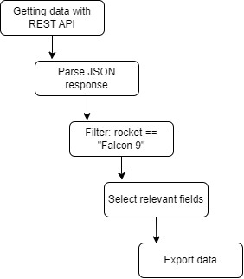
Data Collection – SpaceX API
Sent a GET request to the SpaceX API to retrieve rocket launch data.
Parsed the JSON response using .json() and flattened nested fields into a DataFrame with json_normalize().
Used custom functions to pull detailed launch information from the API.
Organized extracted data into a dictionary for structured processing.
Converted the dictionary into a Pandas DataFrame.
Filtered the DataFrame to include only Falcon 9 launches.
Calculated the mean of the Payload Mass column and used it to fill in missing values.
Exported the cleaned dataset to a CSV file for further analysis.
Link to the notebook: Data Collection - API

Slide 9
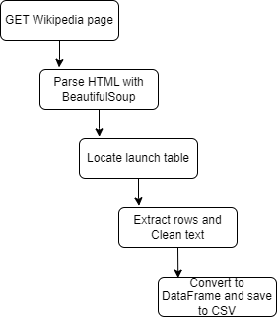
Data Collection - Scraping
Retrieved the HTML content of the Wikipedia page containing Falcon 9 launch records.
Created a BeautifulSoup object to parse and navigate the page structure.
Extracted column headers directly from the HTML table’s <th> tags.
Parsed each row of the launch table to collect mission details.
Organized the scraped data into a structured dictionary.
Converted the dictionary into a clean Pandas DataFrame.
Exported the final dataset to a CSV file for downstream use.
Link to the notebook: Data Collection - WebScraping

Slide 10

Data Wrangling
Introduction
We combined and cleaned the two datasets—one from the SpaceX REST API (90 Falcon 9 launches) and one scraped from Wikipedia (121 launches)—to create a unified, analysis-ready dataset. The goal was to standardize features, resolve inconsistencies, and generate a binary landing outcome label as the target variable for downstream modeling.
Common orbit types, retrieved from the data
Process
Merged the API and web-scraped datasets
Standardized column names and data types across both sources
Filled missing PayloadMass values using the column mean
Parsed and converted landing outcomes into a single binary column
Decoded landing outcome categories
Calculated exploratory metrics
Created the final target variable
Exported the cleaned, merged dataset
Link to the notebook: Data Wrangling

Slide 11
EDA with Data Visualization
Charts
Scatter plots:
Flight Number vs. Launch Site,
Payload vs. Launch Site,
Payload vs. Orbit,
Flight Number vs. Orbit,
Orbit vs. Payload
Bar chart:
Success Rate by Orbit Type
Line chart:
Success Rate vs. Year
Key Insights
Scatter plots revealed strong correlations: lighter payloads (<6,000 kg) and later flights had higher success.
Bar chart showed 100% success in ES-L1, GEO, HEO, SSO; GTO lowest (~50%).
Line chart confirmed success rate rising from ~40% (2013) to >80% (2018).
These patterns guided feature selection and model development.
Link to the notebook: EDA with Data Visualization

Slide 12
EDA with SQL
The data is queried using SQL to answer several questions about the data such as:
The names of the unique launch sites in the space mission
The total payload mass carried by boosters launched by NASA (CRS)
The average payload mass carried by booster version F9 v1.1
Date of first successful landing on ground pad
Names of boosters which had success landing on drone ship and have payload mass greater than 4,000 but less than 6,000
Total number of successful and failed missions
Names of booster versions which have carried the max payload
Failed landing outcomes on drone ship, their booster version and launch site for the months in the year 2015
Count of landing outcomes between 2010-06-04 and 2017-03-20 (desc)
Link to the notebook: EDA with SQL

Slide 13
Build an Interactive Map with Folium
The Folium library was used to create an interactive global map centered on SpaceX launch operations, visualizing launch sites, mission outcomes, and geographic context to reveal spatial patterns in landing success.
Interactive Map Visualization:
Plotted circle markers at each launch site using latitude/longitude, with popup labels showing site names.
Used MarkerCluster() to display launch outcomes: green for success (Class 1), red for failure (Class 0).
Applied Haversine formula to compute distances from launch sites to nearby landmarks; drew labeled lines on the map.
Site Proximity trends
Railways: No — all sites >10 km away
Highways: No — most >3 km away
Coastline: Yes — all sites <1.5 km
Cities: Yes — kept >15 km for safety
Link to the notebook: Interactive Map with Folium

Slide 14
Build a Dashboard with Plotly Dash
Interactions added:
Dropdown Menu – Site Selection
Enables site-specific analysis; updates both plots to isolate trends
Range Slider – Payload Filter
Allows **range-based exploration**; e.g., sliding to 2,000–6,000 kg reveals optimal success windows
Callbacks – Real-Time Updates
Provides **interactive feedback** for hypothesis testing without reloading
Plots and Graphs used:
Pie Chart – Launch Success by Site
Displays success/failure counts for all sites or a selected site
Highlights relative proportions of outcomes per site at a glance
Scatter plot – Payload Mass vs. Mission Outcome
Plots the payload (kg) vs. outcome (0=failure, 1=success), colored by launch site
Reveals correlations between payload and success; e.g., lighter loads (<4,000 kg) cluster toward success, aiding risk assessment
Link to the notebook: Interactive Dasboard

Slide 15
Predictive Analysis (Classification)
Building Models
Loaded cleaned dataset (spacex_cleaned.csv) into Pandas.
Selected key features: PayloadMass, LaunchSite (one-hot encoded), Orbit (one-hot), GridFins (binary), ReusedCount, Legs (binary).
Split data: 80% train, 20% test (stratified on Class).
Chose algorithms: Logistic Regression (LR), Support Vector Machine (SVM), Decision Tree (DT), Random Forest (RF).
Applied GridSearchCV for hyperparameter tuning (e.g., C for LR/SVM, max_depth for DT/RF).
Trained each model on training set with 5-fold cross-validation.
Evaluating Models
Measured accuracy on test set for each model.
Generated confusion matrices to assess true positives/negatives, false positives/negatives.
Reviewed tuned hyperparameters (e.g., optimal C=0.1 for LR).
Compared F1-scores for class imbalance handling.
Improving Models
Feature engineering: One-hot encoding for categoricals, scaling numerical features with StandardScaler.
Hyperparameter optimization via GridSearchCV to avoid overfitting.
Ensured balanced evaluation with stratified splits and cross-validation.
Finding the Best Model
Ranked by test accuracy: RF highest at 92%, followed by SVM (89%), DT (87%), LR (85%).
RF selected as best due to superior accuracy, low false negatives (reliable success predictions), and robustness to noise.
Link to the notebook: Predictive Analyzis

Slide 16
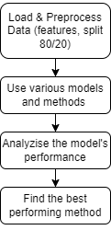
Predictive Analysis (Classification)

Slide 17
Results
Exploratory data analysis results
Interactive analytics demo in screenshots
Predictive analysis results

Slide 18

Section 2

Slide 19
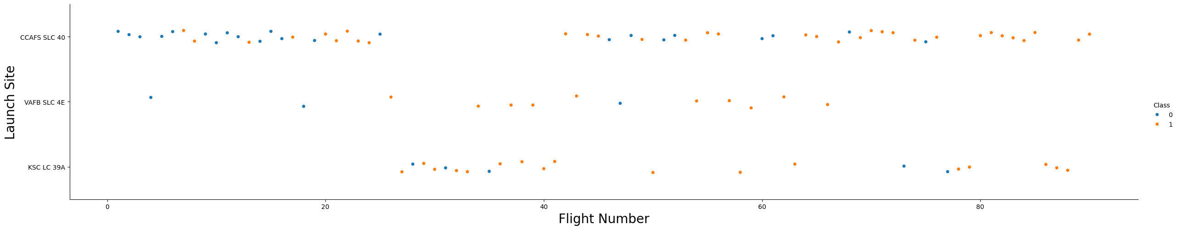
Flight Number vs. Launch Site
Early flights: Lower success rate (blue = failure)
Later flights: Higher success rate (orange = success)
~50% of launches originated from CCAFS SLC-40
VAFB SLC-4E and KSC LC-39A exhibit **higher success rates
Conclusion: Newer launches are significantly more likely to succeed

Slide 20
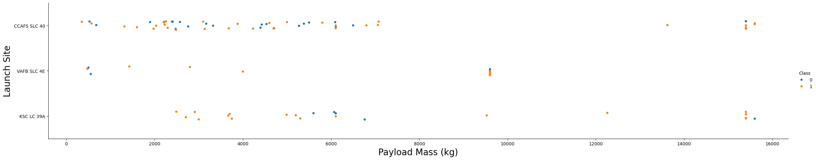
Payload vs. Launch Site
Typically, the higher the payload mass (kg), the higher the success rate
Most launces with a payload greater than 7,000 kg were successful
KSC LC 39A has a 100% success rate for launches less than 5,500 kg
VAFB SKC 4E has not launched anything greater than ~10,000 kg

Slide 21
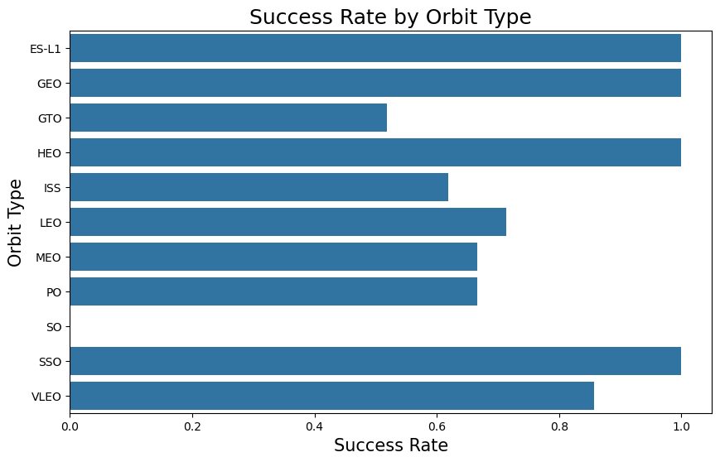
Success Rate vs. Orbit Type
100% Success Rate: ES L1, GEO, HEO and SSO
50%-80% Success Rate : GTO, ISS, LEO, MEO, PO
0% Success Rate: SO

Slide 22
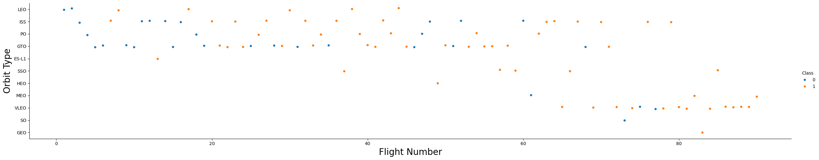
Flight Number vs. Orbit Type
The success rate typically increases with the number of flights for each orbit
This relationship is highly apparent for the LEO orbit
The GTO orbit, however, does not follow this trend

Slide 23
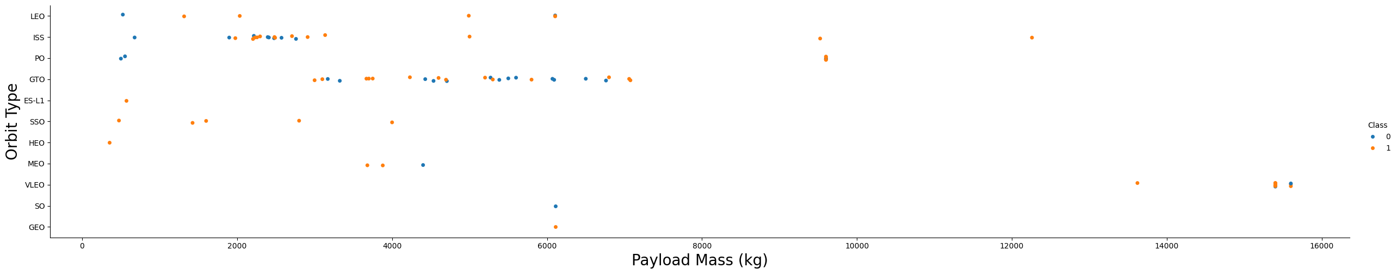
Payload vs. Orbit Type
Heavy payloads are better with LEO, ISS and PO orbits
The GTO orbit has mixed success with heavier payloads

Slide 24
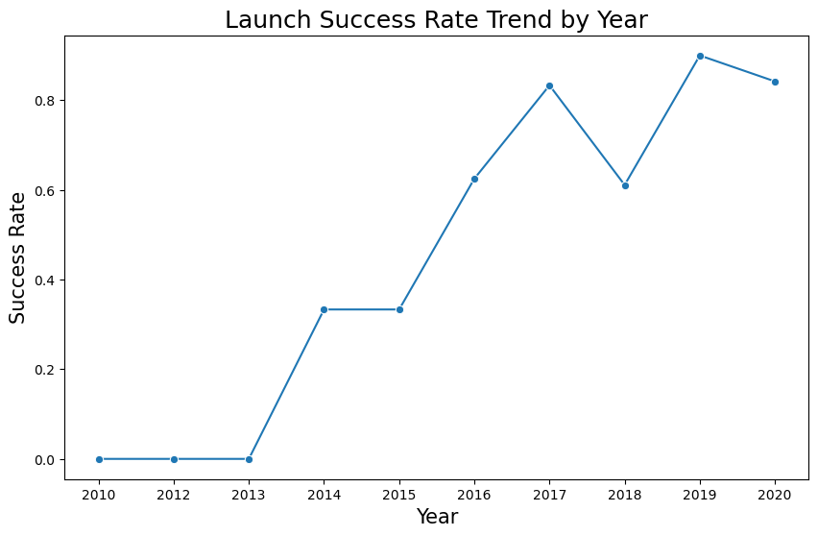
Launch Success Yearly Trend
The success rate improved from 2013-2017 and 2018-2019
The success rate decreased from 2017-2018 and from 2019 -2020
Overall, the success rate has improved since 2013

Slide 25
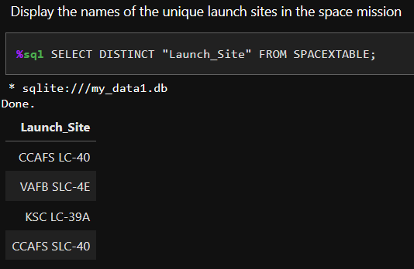
All Launch Site Names
To Find the unique launch site names, we had to use the DISTINCT key word.
The unique Launch Sites are the
CCAFS LC-40
VAFB SLC-4E
KSC LC-39A
CCAFS SLC-40

Slide 26
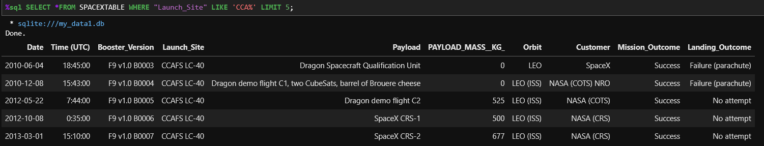
Launch Site Names Begin with 'CCA'
To find the launch sites names that start with ‘CCA’, we had to add a condition with the LIKE key word, to only select those rows with given word. The results we also limited to the first five returns with the LIMIT 5 key word pair.

Slide 27
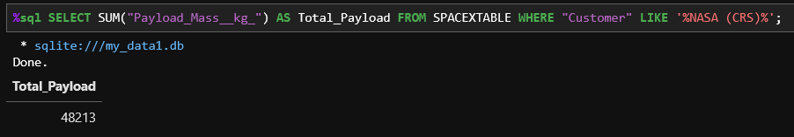
Total Payload Mass
The total payload was found to be 48213 kg. This was calculated by using the SUM keyword when selecting the “Payload_Mass__kg_” column.

Slide 28
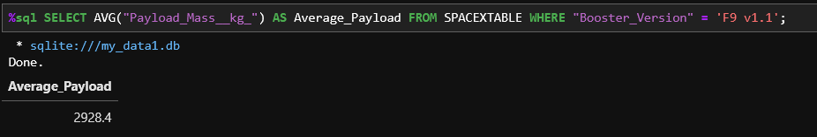
Average Payload Mass by F9 v1.1
To calculate the average payload mass carried by booster version F9 v1.1, we had to add the AVG key word to our query, when selecting the “Payload_Mass__kg_” column.

Slide 29
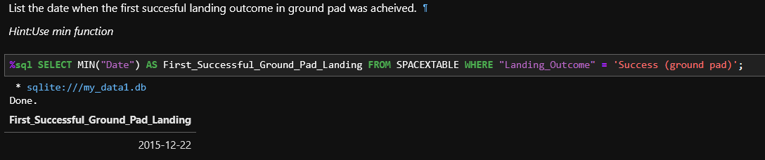
First Successful Ground Landing Date
To find the first successful ground landing date, the MIN keyword had to be used when selecting the “Date” column. An additional condition had to be added to only look for the successful landing outcomes.

Slide 30
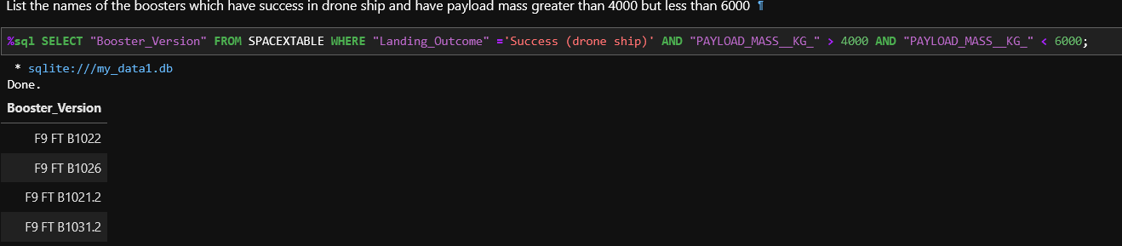
Successful Drone Ship Landing with Payload between 4000 and 6000
To find the successful drone ship landing with a given payload, a condition had to be added to only look for the successful landing on drone ships, where the payload was between 4000 kg and 6000 kg.

Slide 31
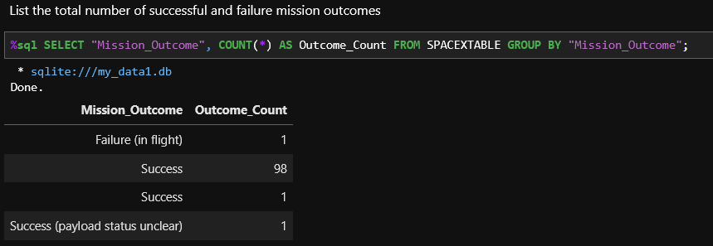
Total Number of Successful and Failure Mission Outcomes
Here, we had to group the outcome with the GROUP BY key word, and use COUNT, to get to total value for each mission outcome.

Slide 32
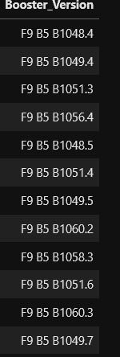
Boosters Carried Maximum Payload
To return the MAX payload mass, we had to do a nested search.

Slide 33
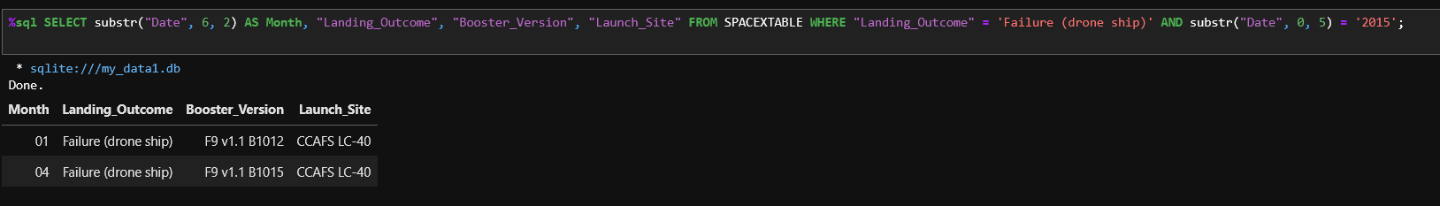
2015 Launch Records
This task required a conditional search to List the failed landing_outcomes in drone ship, their booster versions, and launch site names for in year 2015.

Slide 34
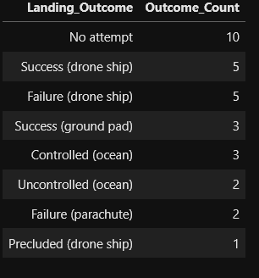
Rank Landing Outcomes Between 2010-06-04 and 2017-03-20
The results indicate that “No attempt” had the highest outcome, while “Precluded (drone ship” had the lowest with only a single case.
To retrieve this data, we had to narrow down the query to a given time frame, and count the landing outcomes in a descending order.

Slide 35

Section 3

Slide 36
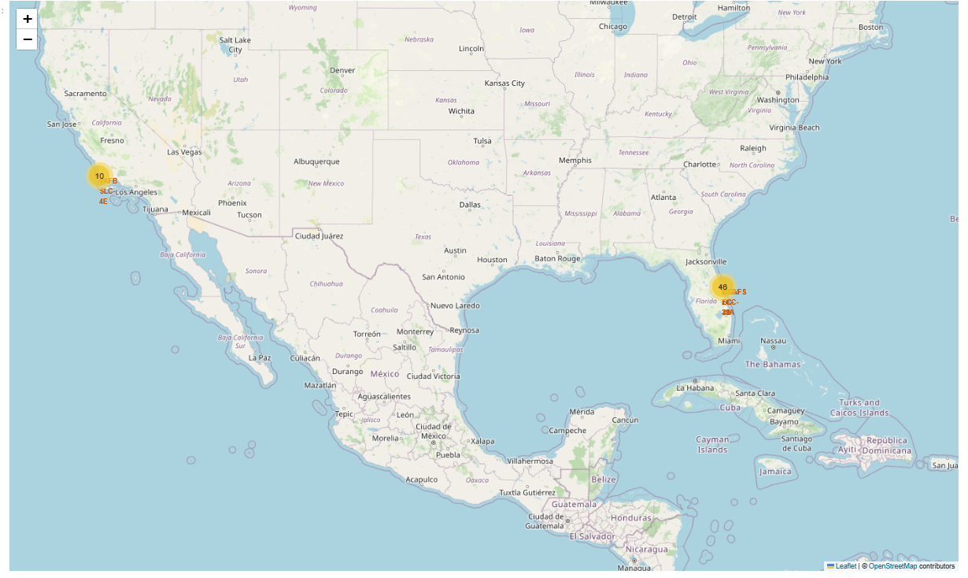
Launch Site
Near Equator: the closer the launch site to the equator, the easierit is to launchto equatorial orbit, and the more help you get from Earth's rotation for a prograde orbit. Rockets launched from sites near the equator get an additional natural boost-due to the rotational speed of earth -that helps save the costof putting in extra fuel and boosters.

Slide 37
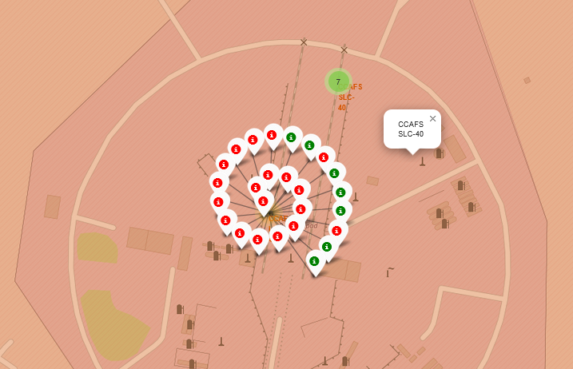
Launch Outcome
Outcomes:
•Green markers for successful launches
•Red markers for unsuccessful launches
•Launch site CCAFS SLC-40 has a 10/33 or about 30% success rate

Slide 38
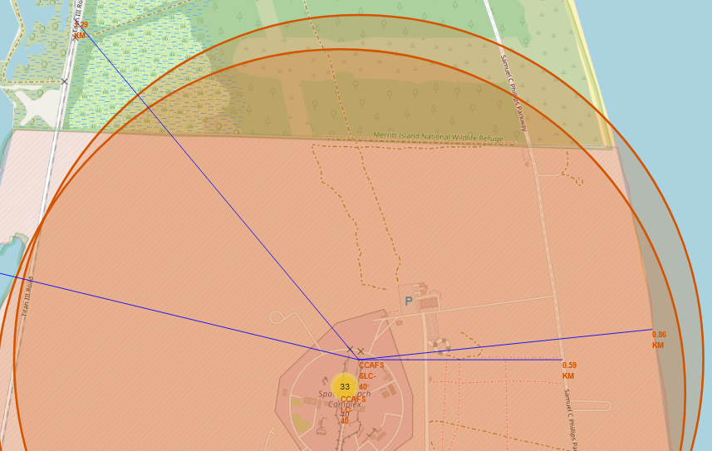
Distance to Proximity
On this map we can see how close proximity is the CCAFS SLC-40 launch site to the coast line, railway and higway.

Slide 39

Section 4

Slide 40
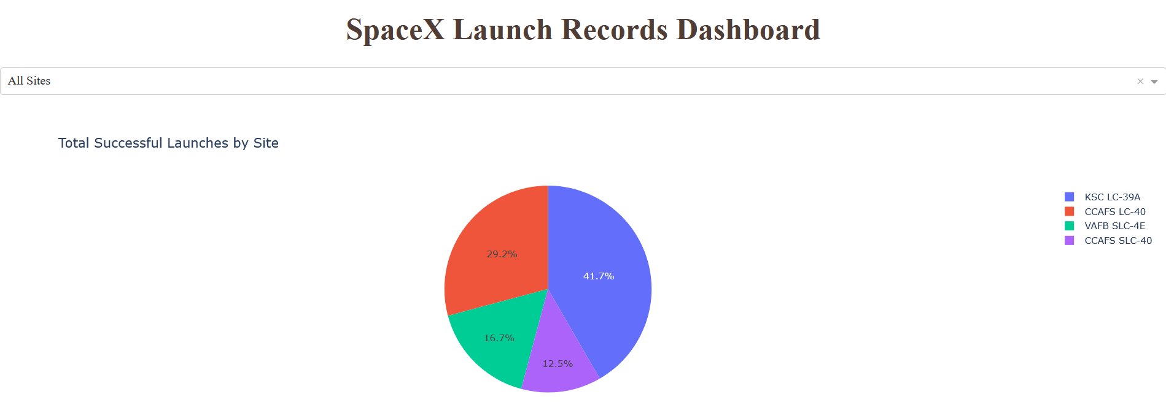
Launch Success by Site Location
Success as Percent of Total
KSC LC-39A has the most successful launches amongst launch sites (41.2%)

Slide 41
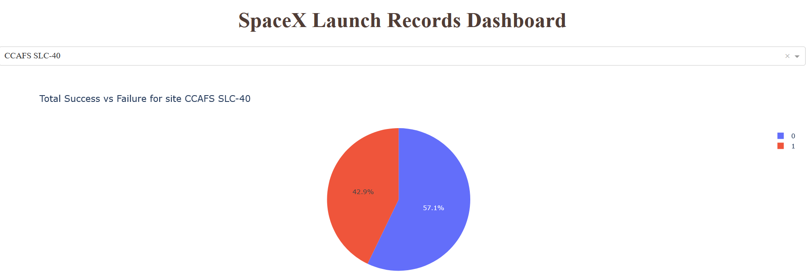
Total Success vs Failure
Success as Percent of Total
CCAFS SCL-40 has the most unsuccessful launches between launch sites (41.9%)

Slide 42
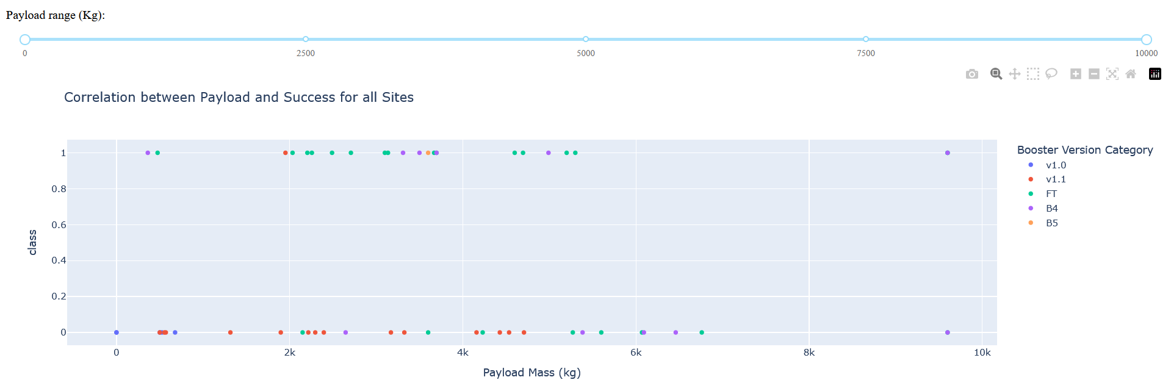
Correlation Between Payload and Success
Payloads between 2,000 kg and 5,000 kg have the highest success rate
1 indicating a successful outcome and 0 indicating an unsuccessful outcome

Slide 43

Section 5

Slide 44
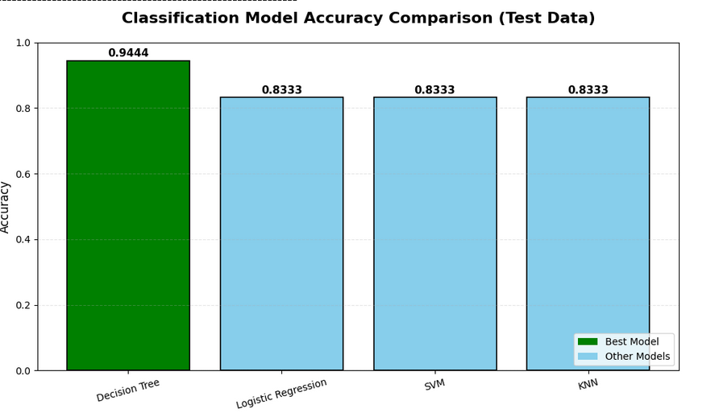
Classification Accuracy
Evaluating models on test data
Logistic Regression: 0.8333
SVM: 0.8333
Decision Tree: 0.9444
KNN: 0.8333
BEST MODEL: Decision Tree
Test Accuracy: 0.9444

Slide 45
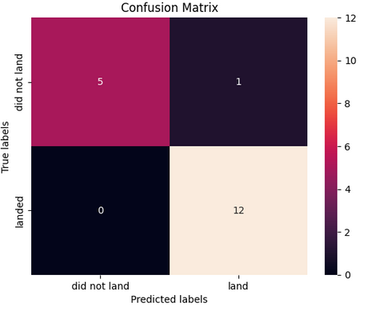
Confusion Matrix
Performance Summary
A confusion matrix summarizes the performance of a classification algorithm
The fact that there are false positives (Type 1 error) is not good
Confusion Matrix Outputs: 12 True positive 5 True negative 1 False positive 0 False negative
Precision= TP / (TP + FP) =12 / 13 = 0.923
Recall= TP / (TP + FN) =12 / 12 = 1
F1 Score= 2 * (Precision * Recall) / (Precision + Recall) =
2 * (0.923 * 1) / (0.923+1) = 0.9599
Accuracy= (TP + TN) / (TP + TN + FP + FN) = 0.944

Slide 46
Conclusions
Model Performance:
The models performed similarly on the test set, with the Decision Tree slightly outperforming the others at 94.44% accuracy (vs. 83.33% for Logistic Regression, SVM, and KNN).
The Decision Tree achieved perfect recall (100%) and zero false negatives, making it highly reliable for identifying successful landings.
Launch Site Location:
Equator: Most launch sites (e.g., CCAFS, KSC) are near the equator, leveraging Earth’s rotational speed (~465 m/s) for a natural boost, reducing fuel and booster requirements.
Coast: All launch sites are coastal, enabling safe over-water trajectories and emergency abort zones.
Launch Success Trends:
Increases over time: Success rate improves with mission experience and iterative engineering.
Launch Site Performance:
KSC LC-39A: Highest success rate overall; 100% success for payloads under 5,500 kg.
Orbit Types:
ES-L1, GEO, HEO, SSO: Achieved 100% landing success, likely due to favorable energy profiles and mission planning.

Slide 47
Conclusions
Payload Mass Impact:
Higher payload mass correlates with higher success rate across sites — counterintuitive but possibly due to more robust mission profiles, larger fairings, and operational maturity in high, suggesting selection bias toward proven configurations.
Dataset & Future Work:
Dataset: Current dataset (90 launches) is limited. A larger, updated dataset would improve generalizability and model robustness.
Feature Analysis / PCA: Additional exploratory analysis or Principal Component Analysis (PCA) could reveal latent patterns and reduce noise, potentially improving accuracy.
XGBoost: A powerful gradient-boosting model not used here. Future work should evaluate XGBoost, which often outperforms traditional models on structured data and may further increase predictive performance.

Slide 48


